Slide 1
Data Exploration and Visualization with Tableau
Connor Smith, MS
Informatics research associate

Slide 2
Roadmap for Today
Introductions
Getting your Data
Building your Dataset
EDA/Configuration
Tableau Elements
Worksheets
Dashboards
Stories
Licenses/Publishing
Additional Concepts

Slide 3
Who I am
Education
MS Bioinformatics/Computational Biomedicine (OHSU DMICE 2019)
BS Biology (OSU 2014)
Work Experience
Informatics Research Associate for DMICE (03/18 to Present)
Senior HRIS Analyst at OHSU (10/17 – 03/18)
HRIS Analyst at OHSU (05/16 – 10/17)
Human Resources Specialist at OHSU (07/15 – 05/16)

Slide 4
EXERCISE: Personal Introductions

Slide 5
Past Projects in Tableau
https://public.tableau.com/profile/connor.jp.smith#!/
Totten AM, Smith C, Dunham K, Jungbauer RM, Graham E. Improving Access to and Usability of Systematic Review Data for Health Systems Guidelines Development. Methods Research Report. (Prepared by the Pacific Northwest Evidence-based Practice Center under Contract No. 290-2015-00009-I.) AHRQ Publication No. 19-EHC010-EF. Rockville, MD: Agency for Healthcare Research and Quality. February 2019. Posted final reports are located on the Effective Health Care Program search page. DOI: https://doi.org/10.23970/AHRQEPCMETHENGAGEIMPROVING.
Projects not posted online:
Visualizing Stop Code usage in VA

Slide 6
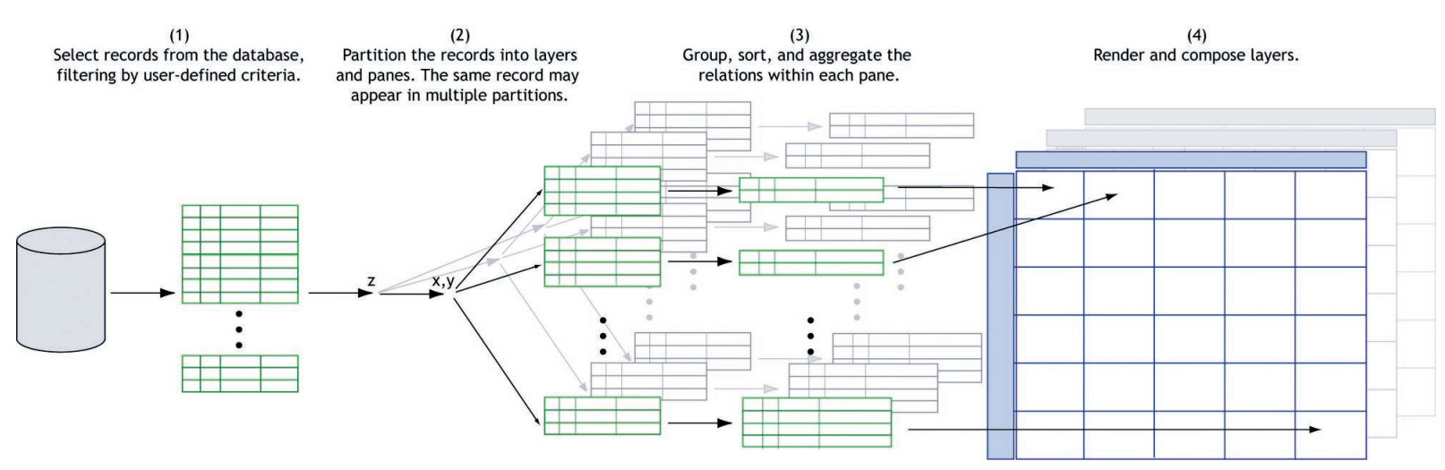
Introduction to Tableau
Started from a 2003 Thesis
https://graphics.stanford.edu/papers/polaris_extended/polaris.pdf
Dynamic Visualization of Relational Data
https://www.tableau.com/about/blog/2016/7/if-i-were-new-tableau-again-3-things-no-one-told-me-56368?__src=liftigniter&__widget=learn-recs-li&li_source=LI&li_medium=learn-recs-li

Slide 7


Slide 8
Viz of the Day
https://public.tableau.com/en-us/s/gallery
Featured visualizations, great source of ideas

Slide 9






Tableau vs. Open-source
Very quick for prototyping, accessible interactive functionality
Used a lot in corporate and healthcare settings
Little programming needed
More flexibility
Open source, minimal cost involved
Not necessarily one or the other

Slide 10
Installing Tableau Public
https://public.tableau.com/en-us/s/download

Slide 11
Getting Your Data into Tableau Public
Google Sheets
Can directly connect to Google Sheets
https://docs.google.com/spreadsheets/d/1hHHLWeLllVgsSZhWZxo_qXuINRnEBnDc7UaCCiXysys/edit?usp=sharing
Using a downloaded file
GitHub
https://github.com/ConnorJPSmith/TableauWorkshop
Other options
Database Connections (SQL Server, MySQL, etc.)
Data Files (SAS, R, etc.)

Slide 12
DEMO: Interfacing with the interface

Slide 13
EXERCISE: Connect to your data (5 mins)
Option 1: Connect to Google Sheets
Option 2: Download the data
Under the To a Server section, click Google Sheets (it may be under More…)
Authenticate Google account
Enter URL, click Search: https://docs.google.com/spreadsheets/d/1hHHLWeLllVgsSZhWZxo_qXuINRnEBnDc7UaCCiXysys/edit?usp=sharing
Click Connect
Download from Google Sheets or GitHub
https://docs.google.com/spreadsheets/d/1hHHLWeLllVgsSZhWZxo_qXuINRnEBnDc7UaCCiXysys/edit?usp=sharing
https://github.com/ConnorJPSmith/TableauWorkshop
Under to To a File section, click Microsoft Excel
Select the file on your computer

Slide 14
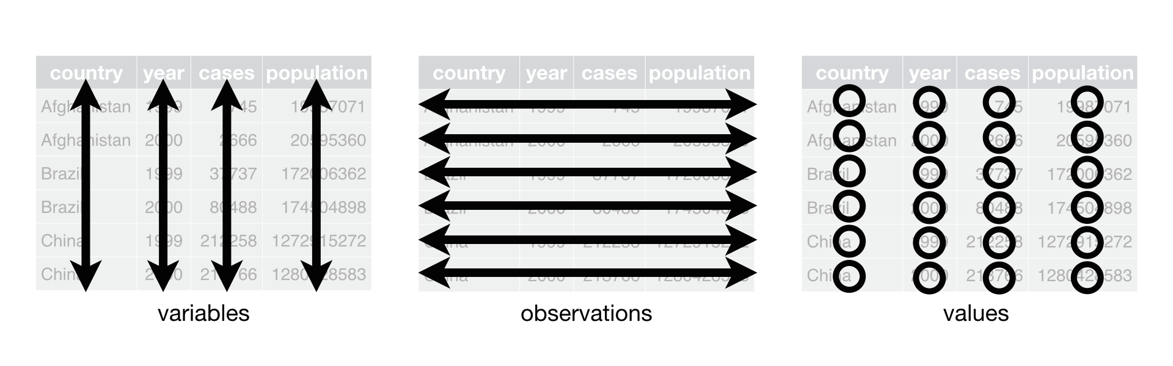
Tidy Data: Not just for R!
https://r4ds.had.co.nz/tidy-data.html

Slide 15
NHANES Data
National Health And Nutrition Examination Survey
Assess health/nutritional status of adults/children in the United States
Types of Survey Questions:
Demographic (Age, Race, Gender, many more…)
Socioeconomic (Marriage Status, Household Income, Education)
Dietary (Foods consumed, dietary supplements)
Health (Body Mass Index, Sleep Trouble, Depression)
Taken from https://laderast.github.io/nhanes_explore/#(7), Ted Laderas

Slide 16
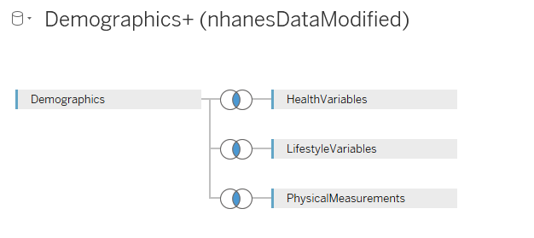
“Building” our Dataset
Demographics
Primary Sheet, all others connect to this one
HealthVariables
LifestyleVariables
PhysicalMeasurements

Slide 17
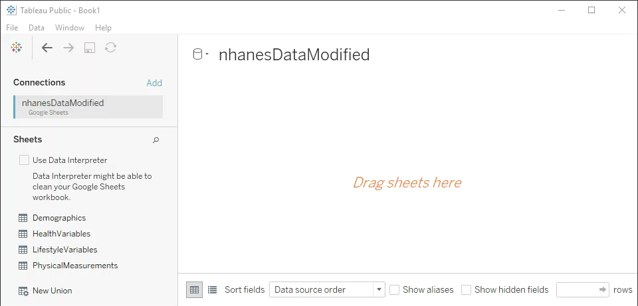
EXERCISE: “Build” our Dataset (5 mins)
On the Data Source Tab, drag Demographics into the blank space
Drag each additional sheet onto space, linking to Demographics using Inner Joins

Slide 18
Data Exploration/Configuration
Data pane is useful for:
Viewing snapshot of our data
Modifying our data
Confirming our dataset was synthesized correctly
Things it can’t do:
Replace NA with nulls en masse
Do this ahead of time
Modifications to Fields:
Rename
Hide
Split
Alias
Grouping
Creating Calculated Fields
Data types
Geographic Type

Slide 19
EXERCISE: Modify our data
10 minutes

Slide 20
Elements build on each other
Stories
Worksheet
Dashboard
Dashboard
Worksheet
Worksheet
Stories
Worksheet

Slide 21
Tableau Elements: Worksheets
Stories
Elements of a Worksheet
Dashboard
Rows
Columns
Filters
Interactive
Hidden
Legends
Tooltips
Basic
Advanced
Worksheet
Worksheet
Worksheet
Notes:
Show the worksheet builder
DEMO: Histogram
DEMO: Heatmap

Slide 22
DEMO: Exploring our data in a Worksheet
Notes:
CLEAR PLAN

Slide 23
EXERCISE: Ask a question about the data, create a visualization to investigate
15 minutes

Slide 24
Tableau Elements: Dashboards
Build multiple worksheets into a comprehensive visualization
Allow worksheets to interact with eachother
Wide range of formatting options
Fixed vs. Automatic
Desktop vs. Mobile
Stories
Dashboard
Worksheet
Worksheet
Worksheet

Slide 25
DEMO: Building a Dashboard
Advanced Dashboards:
https://public.tableau.com/profile/connor.jp.smith#!/vizhome/AHRQT01MethodsPilot-PacificNorthwestEPCV2_1/NonpharmacologicalInterventionsforPain

Slide 26
EXERCISE: Build a Dashboard (20 minutes)
Create an additional Worksheet that can relate to your original
New Worksheet can filter the old OR vice-versa
Create a Dashboard with your two worksheets

Slide 27
Tableau Elements: Stories
Allows you to save the “state” of a Dashboard or Worksheet to tell a “story”
Can include a narrative about the data – great for posterity
https://public.tableau.com/views/AHRQT01MethodsPilot-PacificNorthwestEPCV2_1/GuidedComparison?:embed=y&:display_count=yes&:origin=viz_share_link
Stories
Dashboard
Worksheet
Worksheet
Worksheet

Slide 28
EXERCISE: Tell a story (10 minutes)
Create a Story using your Dashboard
Include 2-3 “slides” and a narrative aspect
OPTIONAL: Add annotations

Slide 29
Tableau Creator/Academic
Tableau Desktop
Included with Creator package
1 year license
Students and Instructors: Can request a free educational license
Can be renewed yearly, if still in school/teaching
Students: https://www.tableau.com/academic/students
Instructors Course/Lab License: https://www.tableau.com/academic/teaching/course-licenses
Instructors Individual License: https://www.tableau.com/academic/teaching
Tableau Server
Included with Creator package
Allows for a hosted server for Tableau visualizations
Can put PHI, if it is secured

Slide 30
Online Tableau Options
Tableau Online
Online hosting of visualization via a paid service
Tableau Public
Desktop client
Desktop client has slightly restricted options
Unlimited Online Publishing
Must create and account
Data must be an extract OR connected to an online, refreshable source
NO PHI
You may allow others to download your workbook/data
Accessible via webpage/embedded

Slide 31
Offline Viewing Option
Tableau Reader
Free software
Allows for users to view a Tableau visualization for free
Must have the file stored locally

Slide 32
OPTIONAL EXERCISE: Publish your work!
Publish to your own Tableau Public account
OR
Publish to BioDataClub account

Slide 33
Additional Concepts: Learning Resources
Free Training
Paid training
Tableau Community
https://www.tableau.com/learn
Online Videos
Broken Down by Concept
Jump in wherever you are stuck
Live Training Webinars
Register Online
Instructor led with audience Q&A
Classroom Training
In Person
Virtual Live Course

Slide 34
Additional Concepts: Certifications
Tableau hosts an opt-in directory of certified individuals
https://www.tableau.com/support/certification/directory
Type | Certification | Cost | Expiration
Desktop | Specialist | $100 | No Expiration
 | Certified Associate | $250 | 2 Years
 | Certified Professional | $600 | 3 Years
Server | Certified Associate | $250 | 2 Years
 | Certified Professional | $800 | 3 Years

Slide 35
Tableau Prep
Tableau Prep
More advanced data cleaning/processing tool
Very in-depth options with EDA capabilities and some ML/NLP
Used to develop a repeatable pipeline for data cleaning
Pipeline can be run ad-hoc after creation
Can export to HYPER (Tableau specific data type), CSV, TXT, etc.
Included with Academic
https://www.tableau.com/products/prep
Tableau Prep Conductor
Server based version
Allows for scheduling and monitoring data pipeline jobs

Slide 36
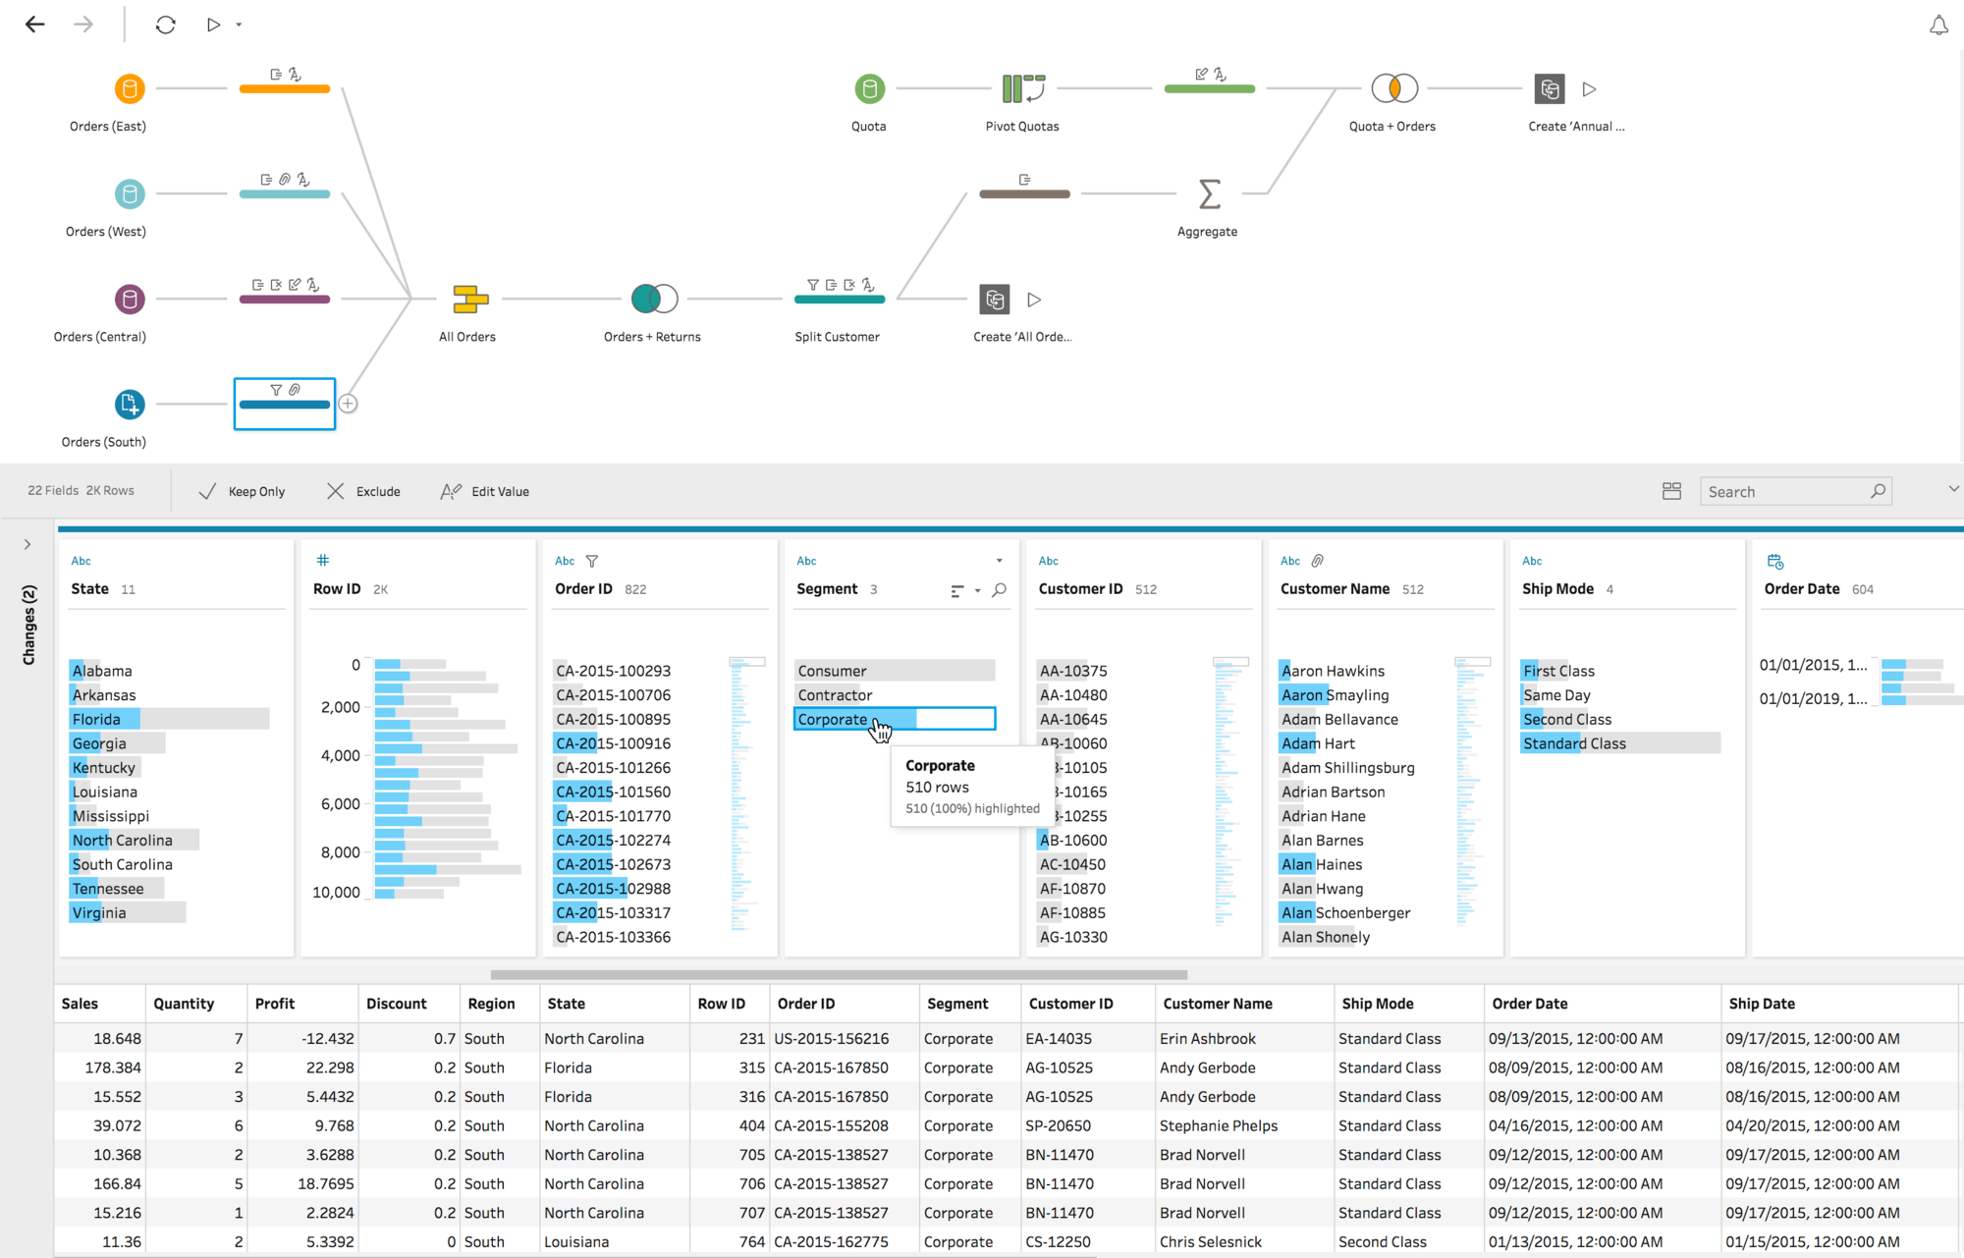
Best practices for tidy data using Tableau Prep

Slide 37
Advanced: Tableau Desktop Extensions
Allow for custom coding for additional functionality
Relatively new (still in Beta)
Require connection to Web Services
Extension is essentially a window to the web
https://extensiongallery.tableau.com/
Currently disabled in Tableau Public

Slide 38
Advanced: Tableau and Big Data
Ability to integrate with Tableau Server to run R/Python code with a Tableau Workbook
Integration with Hadoop and NoSql
Beyond the scope of this course

Slide 39


Thank You
Connor Smith
smitco@ohsu.edu
https://github.com/ConnorJPSmith
https://twitter.com/ConnorJPSmith

